Slide 1

BUSINESS COMMUNICATION
EAK S-1 International Class (3 SKS)
Even Semester 2019/2020
Estu Mahanani, SP., MM
NIDN. 0313047902
Reference:
Bovee & Thill, 2014, Business Communication Essensials, a skills- based approach, pearson education, 6e, Inc (BT)
etc
Compilation of Teaching Material from STEI

Slide 2

BUSINESS COMMUNICATION DESCRIPTION
*This course presents communication as a critical component for success in the workplace. In this class, you will develop a foundation for designing effective messages, both written and oral, from concept to delivery.
*You will use a communication model to identify objectives, analyze audiences, choose information, and create the most effective arrangement and channel for that message.
*Particularly, the course emphasizes elements of persuasive communication: how to design messages for diverse and possibly resistant audiences and how to present that information in a credible and convincing way.

Slide 3
BUSINESS COMMUNICATION DESCRIPTION
Specifically, you will practice drafting and editing clear, precise, and readable written business documents as well as learn to design documents to make information easily accessible to a busy, executive-level reader.
In addition, you will develop and deliver an individual presentation, using appropriate and effective visual support, in which you present a persuasive argument that demonstrates relevance and benefits to an audience at different levels of expertise or interest.

Slide 4
RENCANA PEMBELAJARAN SEMESTER : BUSINESS COMMUNICATION
Pertemuan | Bahan Kajian | Referensi
1 | Understanding Business Communication in Today’s Workplace | BT ch 1
 | Understanding Business Communication in Today’s Workplace | BT ch 2
2 | Planning Business Messages (TITTA) | BT ch 3
3 | Writing Business Messages (ABED) | BT ch 4
4 | Completing Business Messages (SELYA ) | BT ch 5
5 | Crafting Messages for Electronic Media ( NOLA ) | BT ch 6
 | Writing Routine and Positive Messages ( ANNISA ) | BT ch 7
8 | MID TERM TEST

Slide 5
RENCANA PEMBELAJARAN SEMESTER : BUSINESS COMMUNICATION
Pertemuan | Bahan Kajian | Referensi
9 | Writing Persuasive Messages ( NABILAH ) | BT ch 8
10 | Understanding and Planning Reports and Proposals (INDRI) | BT ch 9
11 | Writing and Completing Reports and Proposals (AUREL ) | BT ch 10
12 | Developing Oral and Online Presentations (RINI) | BT ch 11
13 | Building Careers and Writing Résumés ( ENDANG) | BT ch 12
14 | Writing Resume (FINAL EXAM)
15 | Applying and Interviewing for Employment | BT ch 13
16 | Interviewing Role
17 | FINAL EXAM

Slide 6

DAFTAR REFERENSI
Bovee & Thill, 2014, Business Communication Essensials, a skills- based approach, pearson education, 6e, Inc (BT)
2) Ewald and Burnett, Business Communication, Prentice Hall International, Inc.
Latest Edition. (EB)
3). Taylor,S (2009). Communication for Business: A Practical Approach. 4th Ed. New
Delhi: Prentice-Hall. (T)
4). Essentials of Business Communication, 8th Ed., 2010; Mary Ellen Guffey;
Southwestern Cengage
Learning ISBN: 978-

Slide 7

SESSION 1
Understanding Business Communication in Today’s Workplace

Slide 8
LEARNING OBJECTIVES :
Define communication and explain the importance of effective business communication.
Explain what it means to communicate as a professional in a business context.
Describe the communication process model and explain how social media are changing the nature of business communication.
Define ethics, explain the difference between an ethical dilemma and an ethical lapse, and list six guidelines for making ethical communication choices.
Explain how cultural diversity affects business communication anddescribe the steps you can take to communicate more effectivelyacross cultural boundaries.
List four general guidelines for using communication technology effectively.

Slide 9
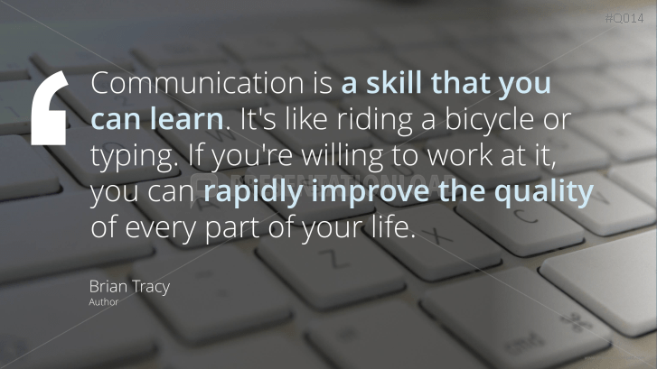

Slide 10
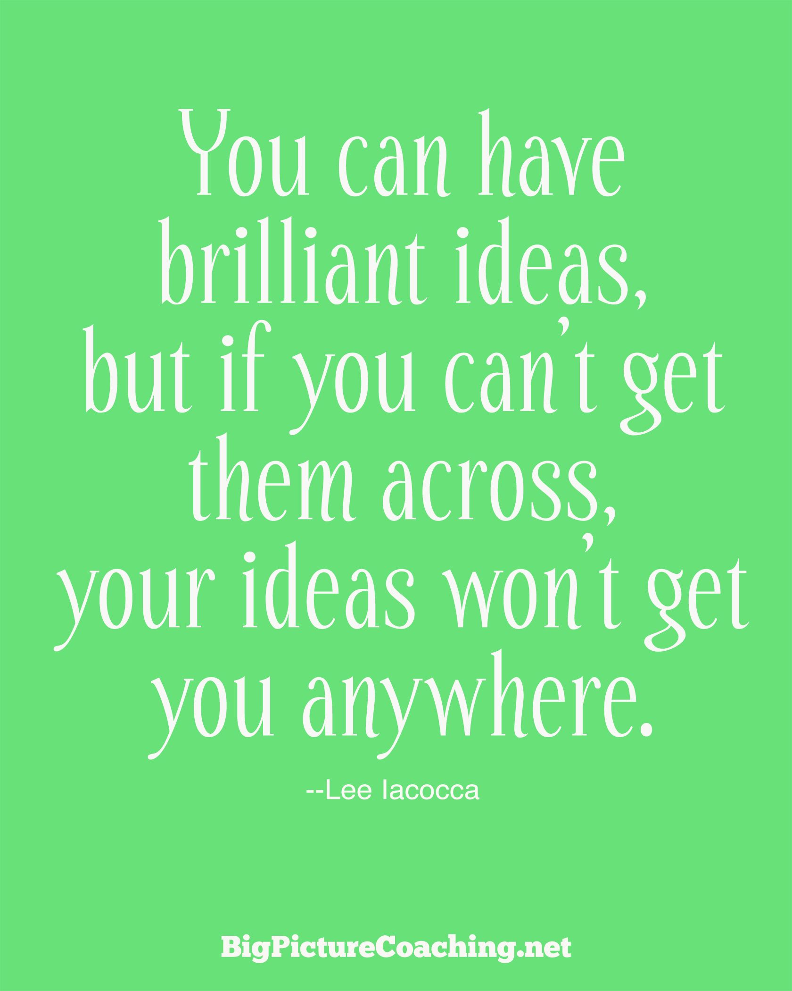

Slide 11
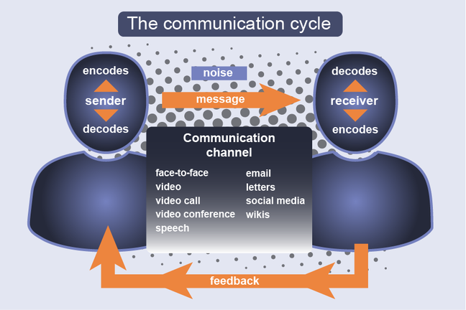

Slide 12
LO 1 Define communication and explain the importance of effective business communication.
Communication is the process of transferring information and meaning between senders and receivers, using one or more written, oral, visual, or electronic media.
The essence of communication is sharing—providing data, information, insights, and inspiration in an exchange that benefits both you and the people with whom you are communicating.
No matter what career path you pursue communication skills will be essential to your success at every stage. You can have the greatest ideas in the world but they're no good to your company or your career if you can't express them clearly and persuasively.
Notes:
Sharing can happen in a variety of ways, including a simple and successful transfer of information, a negotiation in which the sender and receiver arrive at an agreed-upon meaning, and situations in which the receiver creates a different message than the one the sender intended to convey.

Slide 13
Aside from the personal benefits communication should be important to you because it is important to your company, effective communication helps businesses and numerous ways it provides:
Closer ties with important communities in the marketplace
Opportunities to influence conversations, perceptions, and trends
Increased productivity and faster problem solving
Better financial results and higher return for investors
Earlier warning of potential problems, from rising business costs to critical safety issues
Stronger decision making based on timely, reliable information
Clearer and more persuasive marketing messages
Greater employee engagement with their work, leading to higher employee satisfaction and lower employee turnover

Slide 14
Effective communication strengthens the connections between a company and all of its stakeholders, those groups affected in some way by the company's actions: customers, employees, shareholders, suppliers, neighbors, the community, the nation and the world as a whole
To make your communication efforts as effective as possible focus on making them practical, factual, concise, clear, and persuasive so:
provide practical information
give facts rather than vague impressions
present information concise, efficient manner
clarify expectations and responsibilities
offer compelling persuasive arguments and recommendations

Slide 15
LO 2 :Explain what it means to communicate as a professional in a business context.
A good place to start to consider what it means to be a professional. Professionalism is the quality of performing at a high level and conducting oneself with purpose and pride. It means doing more than putting in the hours and collecting a paycheck true professionals go beyond minimum expectations and commit to making meaningful contributions.
Professionalism can be broken down into six distinct traits: striving to excel, being dependable and accountable, being a team player, demonstrating a sense of etiquette making ethical decisions, and maintaining a positive outlook.
Notes:
Professionalism can be broken down into six distinct traits: striving to excel, being dependable and accountable, being a team player, demonstrating a sense of etiquette, making ethical decisions, and maintaining a positive outlook
Given the importance of communication in business, employers expect you to be competent at a wide range of communication tasks:
Organizing ideas and information logically and completely
Expressing yourself coherently and persuasively in a variety of media
Building persuasive arguments to gain acceptance for important ideas
Evaluating data and information critically to know what you can and cannot trust
Actively listening to others
Communicating effectively with people from diverse backgrounds and experiences
Using communication technologies effectively and efficiently
Following accepted standards of grammar, spelling, and other aspects of high-quality writing and speaking
Adapting your messages and communication styles to specific audiences and situations
Communicating in a civilized manner that reflects con-temporary expectations of business etiquette
Communicating ethically, even when choices aren’t crystal clear
Respecting the confidentiality of private company information
Following applicable laws and regulations
Managing your time wisely and using resources efficiently

Slide 16
Given the importance of communication in business, employers expect you to be competent at a wide range of communication tasks, these include:
organizing ideas and information logically and completely
expressing yourself coherently and persuasively in a variety of media
building persuasive arguments to gain acceptance for important ideas
evaluating data and information critically to know what you can and cannot
trust actively listening to others
communicating effectively with people from diverse backgrounds and experiences
using communication technologies effectively and efficiently

Slide 17
following accepted standards of grammar spelling and other aspects of high quality writing and speaking
adapting your message and communication styles to specific audiences and situations
communicating in a civilized manner that reflects contemporary expectations of business etiquette
communicating ethically even when choices aren't crystal clear
respecting the confidentiality of private company information
following applicable laws and regulations
managing your time wisely and using resources efficiently

Slide 18
Every company has a unique communication system that connects people within the organization and connects the organization to the outside world. The system in this broad sense is a complex combination of communication channels such as the internet and department meetings, company policies organizational structure and personal relationships.
To succeed in a job you need to figure out how your company's system operates and how to use it to gather information you need and to share information you want others to have.
Successful business professionals take an audience centered approach for their communication meaning that they focus on understanding and meeting the needs of the readers and listeners Providing the information your audiences need is obviously an important part of this approach, but it also involves such elements as your ability to listen your style of writing and speaking and your ability to maintain positive working relationships.

Slide 19
LO 3 : Describe the communication process model, and explain how social media are changing the nature of business communication.
Even with the best intentions communication efforts can fail. Messages can get lost or simply ignored the. The receiver of a message can interpret it in ways the sender never imagined. Many variations of the communication process model exist but these eight steps provide a practical overview :
The sender has an idea
The sender encodes the ideas as s message
The sender produces the message in a transmittable medium
the sender transmits the message through a channel
the audience receives the message
the receiver decodes the message
the receiver responds to the message
the receiver provides feedback

Slide 20
Notes:
1. The sender has an idea. Whether a communication effort will ultimately be effective starts right here and depends on the nature of the idea and the motivation for sending it. For example, if your motivation is to offer a solution to a problem, you have a better chance of crafting a meaningful message than if your motivation is merely to complain about a problem.
2. The sender encodes the idea as a message. When someone puts an idea into a message, he or she is encoding it, or expressing it in words or images. Much of the focus of this course ison developing the skills needed to successfully encode your ideas into effective messages.
3. The sender produces the message in a transmittable medium. With the appropriate message to express an idea, the sender now needs a communication medium to present that message to the intended audience. To update your boss on the status of a project, for instance, you might have a dozen or more media choices, from a phone call to an instant message to a slideshow presentation.
4. The sender transmits the message through a channel. Just as technology continues to increase the number of media options, it also continues to provide new communication channels senders can use to transmit their messages. The distinction between medium and channel can get a bit murky, but think of the medium as the form a message takes(such as a Twitter update) and the channel as the system used to deliver the message(such as the Internet).
5. The audience receives the message. If the channel functions properly, the message reaches its intended audience. However, mere arrival is not enough. For a message to truly be received, the recipient has to sense the presence of a message, select it from all the other messages clamoring for attention, and perceive it as an actual message (as opposed to random noise).8
6. The receiver decodes the message. After a message is received, the receiver needs to extract the idea from the message, a step known as decoding. Even well-crafted, well-intentioned communication efforts can fail at this stage because extracting meaning is a highly personal process that is influenced by culture, experience, learning and thinking styles, hopes, fears, and even temporary moods. As you saw in Figure 1.1, receivers some-times decode the same meaning the recipient intended, but sometimes they can decode—or re-create—entirely different meanings. Moreover, audiences tend to extract the meaning they expect to get from a message, even if it’s the opposite of what the sender intended.9
7. The receiver responds to the message. In most instances, senders want to accomplish more than simply delivering information. They often want receivers to respond in particular ways, whether it’s to invest millions of dollars in a new business venture or to accept management’s explanation for why it can’t afford to give employee bonuses this year. Whether a receiver responds as the sender hopes depends on the receiver
8. The receiver provides feed back. If a mechanism is available for them to do so, receiver scan “close the loop” in the communication process by giving the sender feedback that helps the sender evaluate the effectiveness of the communication effort. Feedback can be verbal (using written or spoken words), nonverbal (using gestures, facial expressions, or other signals), or both. Just like the original message, however, this feedback from the receiver also needs to be decoded carefully. A smile, for example, can have many different meanings.

Slide 21
The basic communication model presented in your book illustrates how a single idea moves for one sender to one receiver. In a larger sense it also helps represent the traditional nature of much business communication, which was primarily defined by publishing or broadcasting mindset.
However in recent years a variety of technologies enabled and inspired a new approach to business communication. In contrast the publishing mindset the social communication model is interactive and conversational and usually open to all who wish to participate.
Audience members are no longer passive recipients of messages but active participants in a conversation. Social media have given customers and other stakeholders a voice they did not have in the past.
Notes:
The social communication model offers many advantages, but it has a number of disadvantages as well. Potential problems include information overload, fragmented attention, information security risks, distractions that hurt productivity, the need to monitor and respond to numerous conversational threads, and blurring of
the line between personal and professional lives, which can make it difficult for people to disconnect from work
Social communication model is interactive, conversational, and usually open to all who wish to participate. Audience members are no longer passive recipients of messages but active participants in a conversation. Social media have given customers and other stakeholders avoice they did not have in the past. And businesses are listening to that voice

Slide 23
LO 4: Define ethics, explain the difference between an ethical dilemma and an ethical lapse, and list six guidelines for making ethical communication choices
Ethics are the accepted principles of conduct that govern behavior within a society. Ethical behavior is a company-wide concern but because communication efforts are the public face of a company they are subjected to particularly rigors scrutiny from regulators, legislators, investors, consumer groups, environmental groups, labor organizations, and anyone else affected by business activities.
Ethical communication includes all relevant information, is true in every sense, and is not deceptive in any way. In contrast unethical communication can distort the truth or manipulate audiences in a variety of ways. Examples of unethical communication include:
plagiarism, omitting essential information, selective misquoting, misrepresenting numbers, distorting visuals, failing to respect privacy or information security needs.

Slide 24
The widespread use of social media has increased the attention given to the issue of transparency, which in this context refers to a sense of openness, of giving all participants in a conversation access to the information they need to accurately process the messages they are receiving. A key aspect of transparency is knowing who is behind the messages one receives.
Some ethical questions are easy to recognize and resolve but others are not. Deciding what is ethical and complex business situations is not always easy. An ethical dilemma involves choosing among alternatives that are aren't clear-cut.

Slide 25
Perhaps two conflicting alternatives are both ethical and valid or perhaps alternatives lies somewhere in the grey area between clearly right and clearly wrong. Unlike with dilemma an ethical lapse is a clearly unethical and frequently illegal choice.
Ensuring ethical business communication requires three elements: ethical individuals, ethical company leadership, and the appropriate policies and structures to support ethical decision-making.
Many companies establish this explicit ethics policy by using a written code of ethics to help employees determine what is acceptable. Showing employees if the company is serious about ethical behavior is also vital.

Slide 26
LO5 :Explain how cultural diversity affects business communication, and describe the steps you can take to communicate more effectively across cultural boundaries
Throughout your career you will interact with people from a variety of cultures, people who different in race, age, gender, sexual orientation, national and regional attitudes and beliefs, family structure, religion, native language, physical and cognitive abilities life experience, and educational background.
Although the concept is often narrowly framed in terms of ethnic background, a broader and more useful definition of a of diversity includes all the characteristics and experiences that define each of us as individuals. As you learn in this chapter these characteristics and experiences can have a profound effect on the way businesspeople communicate.
Smart business leaders recognize the competitive advantage of a diverse workforce that offers a broader spectrum of viewpoints and ideas helps companies understand and identify with diverse markets and enables companies to benefit from a wider range of employee talents.
For all their benefits diverse workforces and markets do present some communication challenges and understanding the effect of culture on communication is essential.

Slide 27
Culture is a shared system of symbols, beliefs, attitudes, values, expectations, and norms for behaviour. Culture influences the way people perceive the world and respond to others, which naturally affects the way they communicate as both senders and receivers.
These influences operate on such a fundamental level that people often don't even recognize the influence of culture on their beliefs and behaviors. This subconscious affective culture can create friction because it leads people to assume that everybody thinks and feels the way they do. However differences between cultures can be profound.
You don't need to become an expert in the details of every culture with which you do business, but you do need to attain a basic level of cultural proficiency to ensure successful communication.
Every attempt at communication occurs within a cultural context the pattern of physical cues, environmental stimuli, and implicit understanding that convey meaning between two members of the same culture.
However cultures around the world vary widely in the role that context plays in communication. In a high context culture people rely less on verbal communication and more on the context of nonverbal actions and environmental setting to convey meaning.

Slide 28
Cultural context influences legal and ethical behavior which in turn can affect communication. As you conduct business with colleagues and customers around the world you'll find that legal systems and ethical standards differ from culture to culture.
Making ethical choices across cultures can seem complicated but you can keep your messages ethical by applying four basic principles: actively seek mutual ground, send and receive messages without judgment, send messages that are honest, show respect for cultural differences.
The combination of formal and informal rules influences the overall behavior of everyone in a society in areas such as manners, attitudes toward time, individual versus community values, attitudes towards status and wealth, respect for authority and degrees of openness and inclusiveness.
Nonverbal communication (communicating without the use of words) is a vital part of the communication process. Factors ranging from facial expressions to style of dress can influence the way receivers decode messages, and the interpretation of nonverbal signals can vary widely from culture to culture.
Gestures or clothing choices that you don't think twice about for example might seem inappropriate or even offensive to someone from another culture.

Slide 29
People whose hearing vision cognitive ability or physical ability to operate computers or other tools is impaired can be a significant disadvantage in today's workplace. As with other elements of diversity, success starts with respect for individuals and sensitivity to differences.
Employers can also invest in a variety of assistive technologies that help create a vital link for thousands of employees with disabilities, giving them opportunities to pursue a greater range of career paths and giving employers access to a broader base of talent.
In any cross-cultural situation you can communicate more effectively if you heed the following tips; avoid ethnocentrism, avoid stereotyping, don't automatically assume that others think believe or behave as you do, accept differences and others without judging them, learn how to communicate respect in various cultures, tolerate ambiguity and control your frustration, don't be distracted by superficial factors such as personal appearance, recognize your own cultural biases, be flexible and be prepared to change your habits and attitudes, observe and learn the more you know the more effective you'll be.

Slide 30
To write effectively for people who may not be comfortable using your language remember these tips: use plain language, avoid words with multiple meanings, be clear, cite numbers Carefully, avoid slang and be careful with technical jargon and abbreviations, be brief, use short paragraphs, use transitions generously.
When speaking to people whose native language is not your own, you may find these tips helpful: speak clearly simply and relatively slow, look for feedback but interpret it carefully, rephrase if necessary, clarify your meaning with repetition and examples, don't talk down to the other person, learn important phrases in your audience's language, listen carefully and respectfully, adapt your conversation style to the other person's, check frequently for comprehension, clarify what will happen next.
Finally remember that oral communication can be more difficult for audiences because it happens in real time and in the presence of other people.

Slide 31
LO6: List four general guidelines for using communication technology effectively.
Today's businesses rely heavily on technology to facilitate the communication process in fact many of the technologies you might use in your personal life, from Facebook to Twitter to video games are also used in business.
The benefits of Technology are not automatic of course. To communicate effectively you need to keep technology in perspective, use technological tools productively, guard against information overload, and disengage from the computer frequently to communicate in person.
Remember that technology is an aid to communication, not a replacement for it. Technology can't think for you, make up for a lack of essential skills or ensure that communication really happens. No matter how innovative or popular it may be, a technology has value only if it helps deliver the right information to the right people at the right time.
You don't have to become an expert to use most communication technologies effectively, but to work efficiently you do need to be familiar with basic features and functions.

Slide 32
Conversely don't worry about learning advanced features unless you really need to use them. Many software packages contain dozens of obscure features that typical business communicators rarely need.
The overuse or misuse of communication technology can lead to information overload. in which people receive more information than they can effectively process. Information overload makes it difficult to discriminate between useful and useless information inhibits the ability to think deeply about complex situations, lowers productivity, and amplifies employees stress both on the job and at home. Even to the point of causing health and relationship problems.
As a sender, make sure every message you send is meaningful and important to receivers.
Even the best technologies can hinder communication if they are overused. For instance a common complaint among employees, is that managers rely too heavily on email and don't communicate face-to-face often enough.
Speaking with people over the phone or in person can take more time and effort, and can sometimes force you to confront unpleasant situations directly, but it is often essential for solving tough problems and maintaining productive relationships.

Slide 33
Elements of Professionalism
Be the best
Be dependable
Be a team player
Be respectful
Be ethical
Be positive

Slide 34
Exercise 1:
Describe the communication process model, and explain how social media are changing the nature of business communication?
Define communication, and explain the importance of effective business communication?
What is the meaning of professionalism, and What are the six traits of professionalism?

